Slide 1
SUBSCRIBERS GALORE: EXPLORING WORLD’S TOP YOUTUBE CHANNEL
SRI SARADA NIKETAN COLLEGE OF SCIENCE FOR WOMEN,
KARUR
Faculty Mentor
Ms. E. NIRAIMATHI, M.Sc., B.Ed.,
Project done by
M.Kanimozhi - Team Leader
L.Sindhuja - Team Member
T.Boomathi - Team Member
S.Nathiya - Team Member
V.Kamalaveni - Team Member
R.Mohana - Team Member

Slide 2
PROJECT REPORT TEMPLATE
1. INTRODUCTION
1.1 Overview
Project description
A subscriber to a channel on the video-sharing Youtube is a user who has chosen to receive the channel’s content by clicking on that channel’s “ Subscriber” button, and each user’s subscription feed consists of videos published by channels to which the user is subscribed. The ability to subscribe to users was introduced in October 2005Youtube began publishing a list of its most-subscribed channels in April 2006. An early archive of the list dates to May 2006.
All 50 of the channels have surpassed 40 million subscribers, 39 of them have surpassed 50 million subscribers, 7 of them have surpassed 100 million subscribers. Only 1 channel (T-Series) has surpassed 200 million subscribers.
1.2 Purpose
You can subscribe to channels you like to see more content from those channels. You can find a Subscribe button under any YouTube video or on a channel’s page. Once you subscribe to channel, any new videos it publishes will show up in your Subscriptions feed.

Slide 3
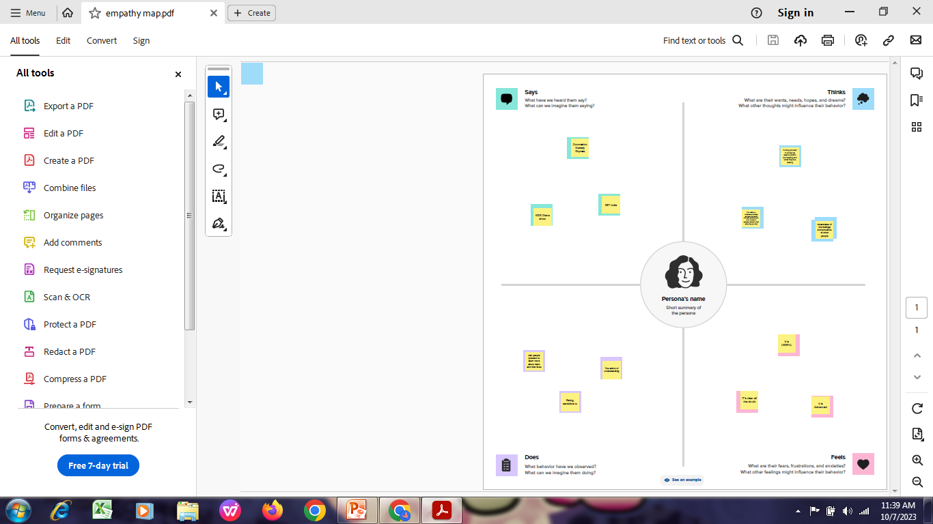
PROBLEM DEFINITIONS & DESIGN THINKING
2.1 Empathy Map

Slide 4
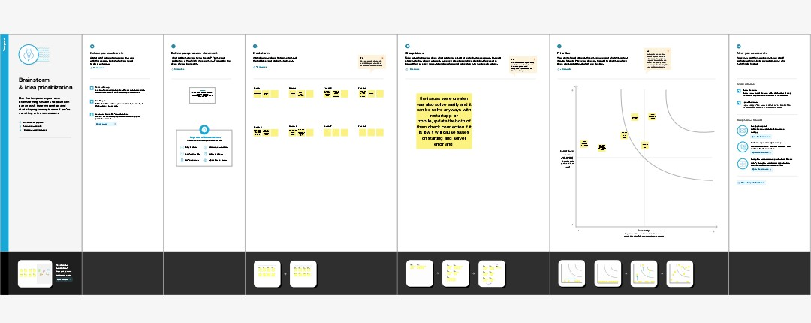
2.2 Ideation & Brainstorm Mapping

Slide 5
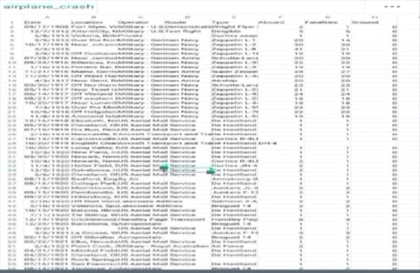

Slide 6
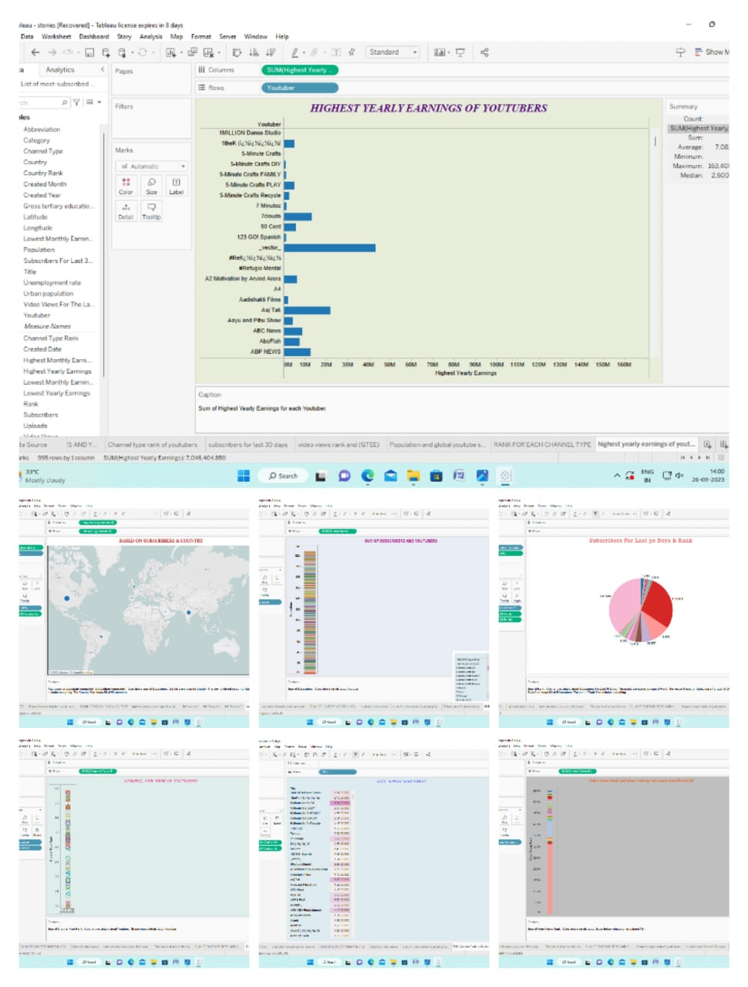
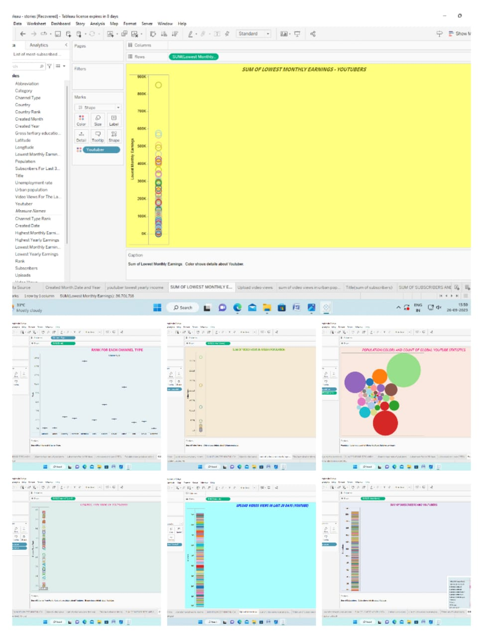
3 RESULT
DASHBOARD

Slide 7
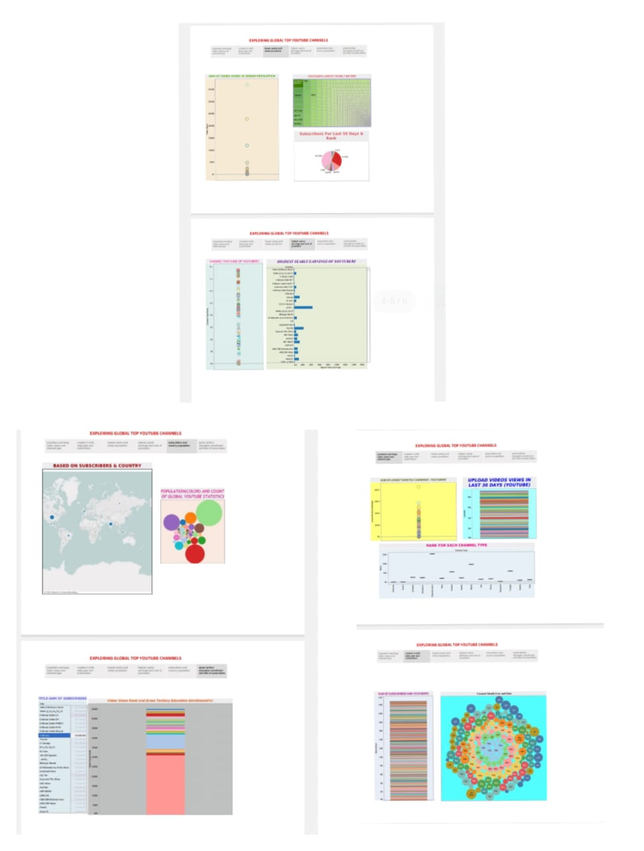
STORY

Slide 8
ADVANTAGES & DISADVANTAGES
ADVANTAGES:
Free of cost.
Can earn money.
A simple way to share.
Can connect with a wide audience.
Also used by students for educational videos.
DISADVANTAGES:
Little difficult to start earning.
Need parental control setup.
To much distraction.
Bullying and defamation.
Not easy to concentrate on a single topic.
APPLICATION
You can watch and like videos and subscribe to channels with a Google Account . But without a YouTube. Even if you have a Google Account, you need to create a YouTube channel to upload videos, comment, or make playlists.

Slide 9
CONCLUSION
In conclusion, YouTube is a very strong growing platform creating lots of opportunities for entrepreneurs and motivated people. The best succeed at it, apart from creating good video content. This is knowing what people like and knowing how to reach those people for which of course you will need a mastery of social media..
FUTURE SCOPE
Youtube will continue to be where people go for informative and educational videos .
As more innovative technology comes out, Youtube will evolve with it. By 2022,it will be even more powerful, and we will see many new changes that are sure to revolutions marketing as a whole.

